Slide 1
EPUT SAFETY CONFERENCE

Slide 2
OXEVISION: USING TECHNOLOGY TO ENHANCE PATIENT SAFETY, OBSERVATIONS & ENGAGEMENT
Oyinkan Akinseye
Customer Success Manager, Oxehealth
Louise Summers
Service Manager, Child and Adolescent Mental Health Service, EPUT

Slide 3
Helping clinicians deliver safer,
higher quality, and more efficient care
EPUT Safety Conference
Oyinkan Akinseye - Customer Success Manager and RMN

Slide 4
What’s This Session About?
Everything you need to know about Oxevision:
What is Oxevision?
What is Oxevision Observations?
Oxevision at EPUT

Slide 5

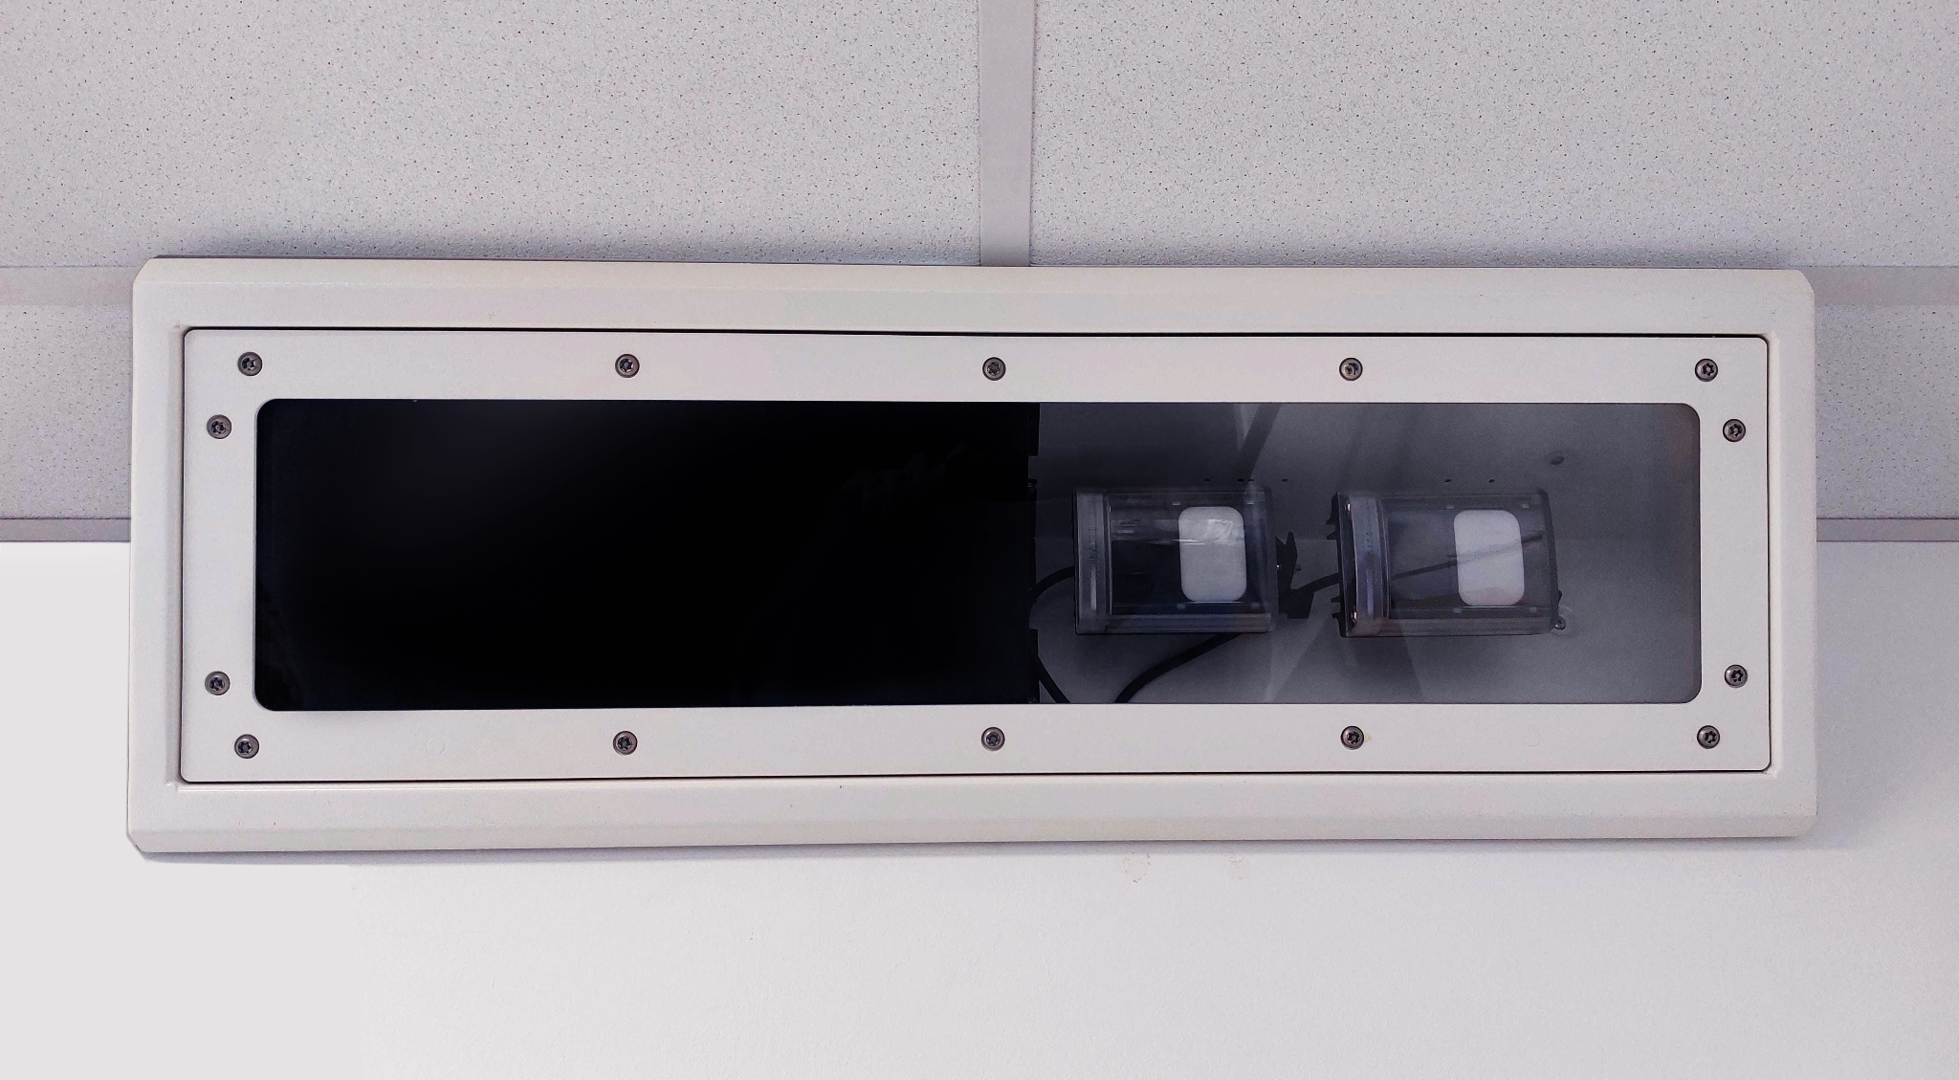
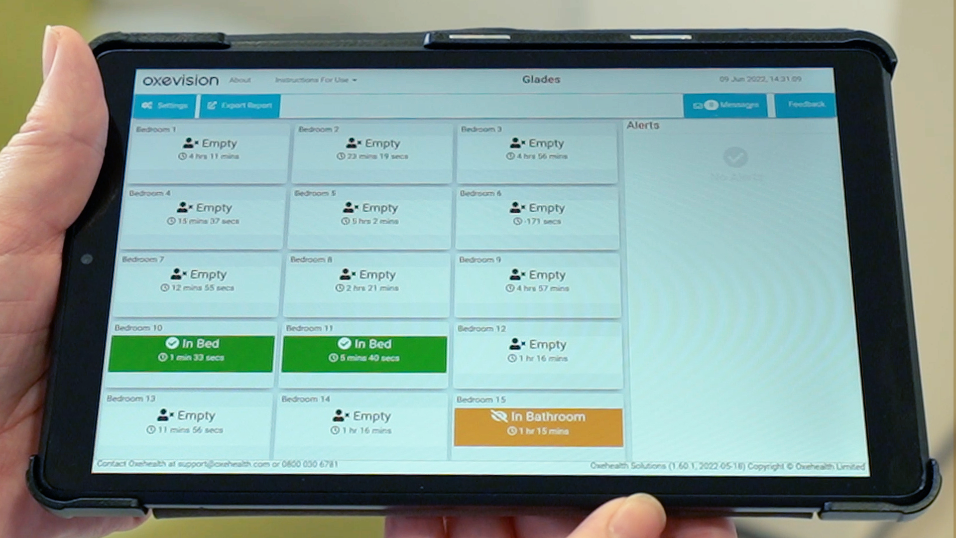
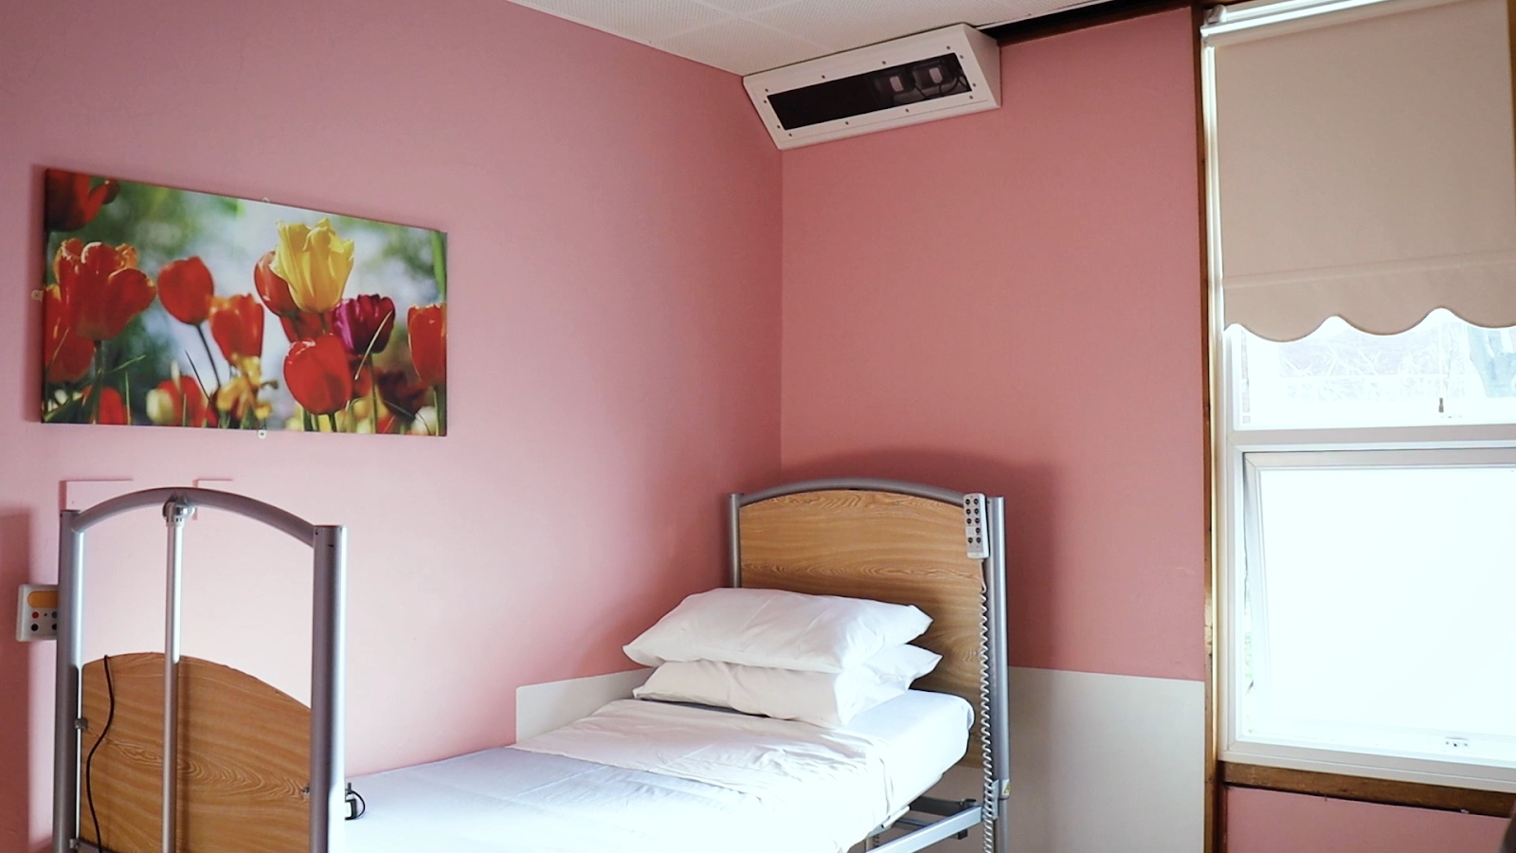
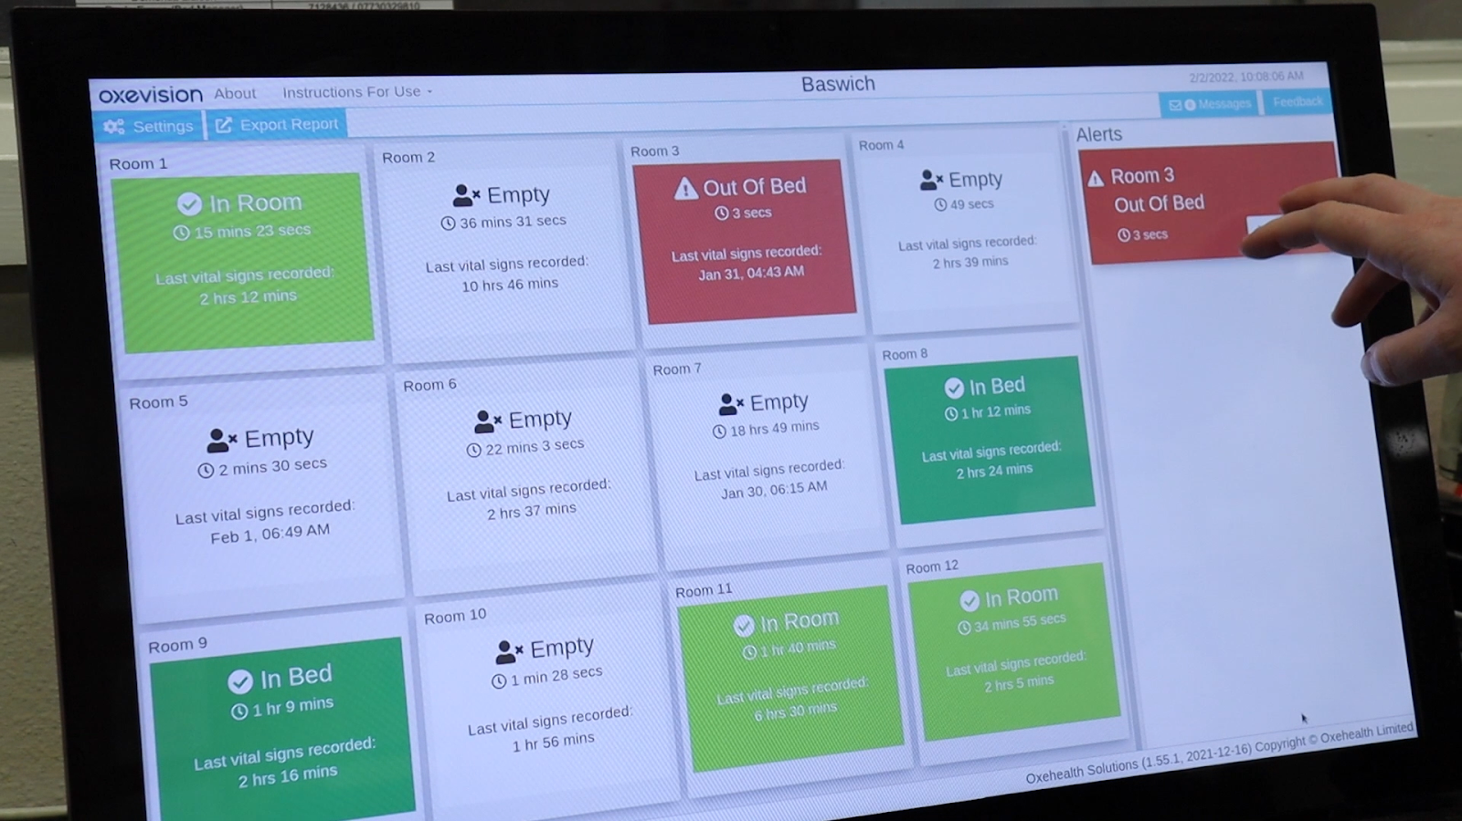



Secure infrared sensitive camera in every room
Infrared sensitive camera in a wall-mounted secure housing unit
Privacy screens for staff to interact
Handheld devices
Nursing station PC
© Midlands Partnership NHS Foundation Trust 2022.
© Midlands Partnership NHS Foundation Trust 2022.
Medical grade cardio-respiratory vital signs¹
Activity based alerts and warnings²
Reports on risk factors over time^{1, 2}
1 The Vital Signs software is registered as a class IIa medical device in the UK & Europe. It is intended for non-invasive spot measurements of pulse rate (50 to 130 ± 3 beats per minute) and estimated breathing rate (8 to 39 ± 2 breaths per minute). It does not provide alerting or alarms for vital signs. The Vital Signs Trends chart is a feature within the Vital Signs software which shows a summary of average vital signs to inform decisions to take further vital signs spot check measurements or check on patients and cannot be used to measure or monitor pulse rate or breathing rate. It is a fixed-installed solution for use within hospitals, general care, and secured environments where a framework exists that mandates periodic checks by a trained professional to ensure subject safety. See Instructions for Use for intended use, contraindications, warnings, cautions, usage directions and maintenance.
2 The Activity Tracker software (including the activity detection, fall risk, location risk, inactivity warning, flexi room, refresh room and activity report products) are Clinical Decision Support System (CDSS) products. The Recent Incident Review product is a video review product. They are not medical devices. See Instructions for Use for intended use, contraindications, warnings, cautions, usage directions and maintenance.
Notes:
If updates are made to this slide please remember to also update the slide in the “Talking to Patients “ deck.

Slide 6
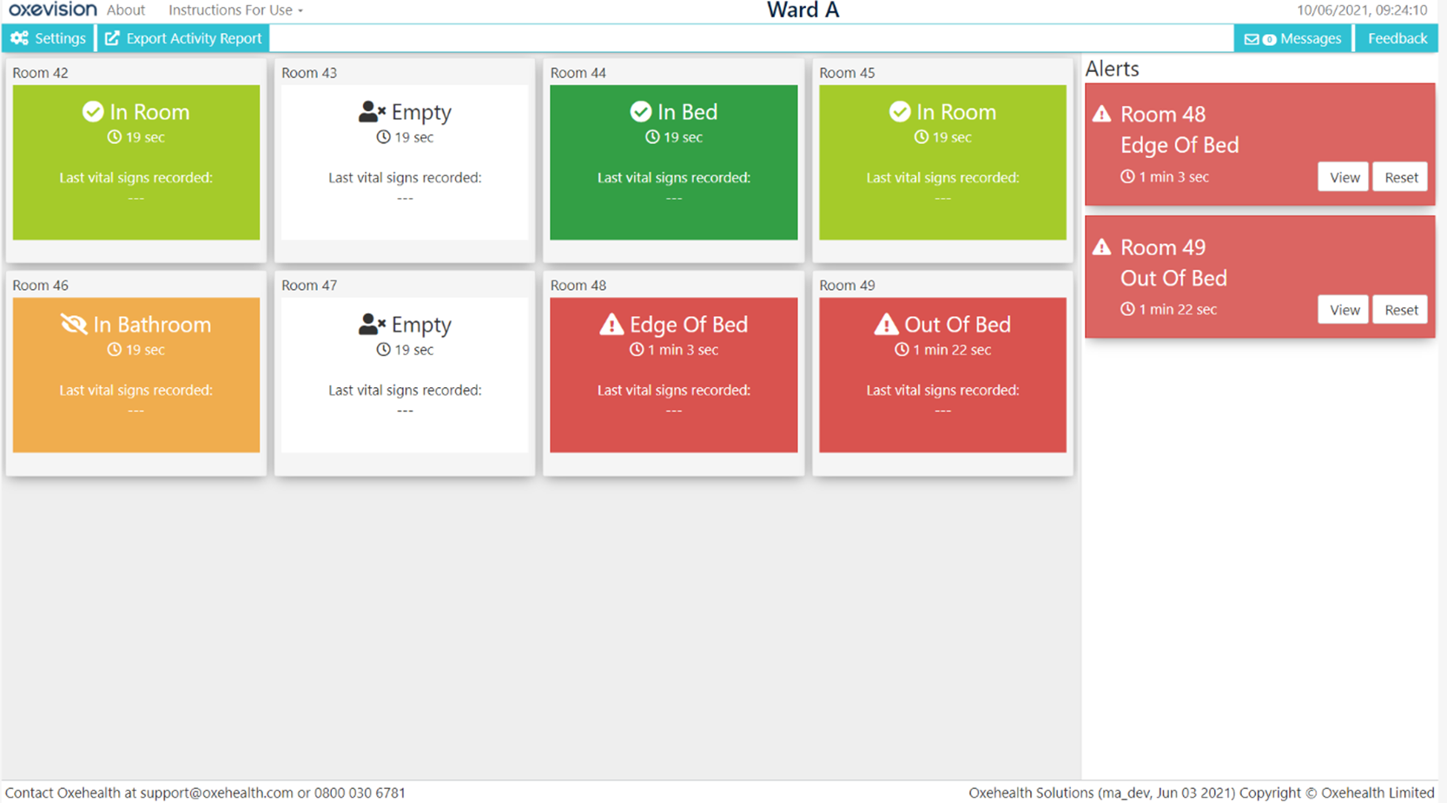
Oxevision: Overview Screen
Default “home screen” acts as a privacy screen for patients
Single tile per patient room
Room tiles show you where a person is in their room and how long they have been there
Simple colours and icons denote room occupancy
Orange tile is a visual warning
Red tile is a visual and audible alert
Alerts pane for audible and visual alerts
Same display for nursing station PC and handheld devices
‘Last vital signs recorded:’ shows you the last time a person’s pulse and breathing rate was taken

Slide 7


Oxevision’s Vital Signs
Supporting observations and improved physical health monitoring
¹ Registered as a Class IIa medical device in the UK & Europe
Medical grade cardio-respiratory vital signs¹

Slide 8
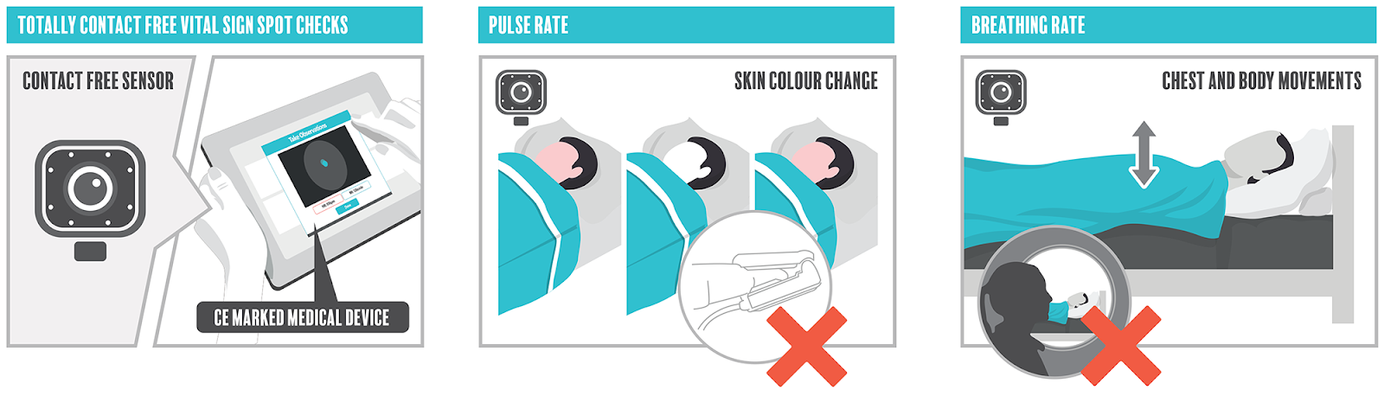

How Does Vital Signs Work?
Bedrooms
A good night’s sleep report
Spot-check measurements of pulse rate and breathing rate - Oxevision will not alert to abnormal pulse rate or breathing rate.
86% of surveyed patients felt their privacy improved (“A good night’s sleep” report)
Patient must be still/resting
100% of surveyed patients felt safer and sleep better at night (“A good night’s sleep” report)
PLEASE NOTE: OXEVISION WILL NOT ALERT TO ANY HIGH, LOW, OR ABNORMAL VITAL SIGNS MEASUREMENTS.

Slide 9
Activity Tracker
Helping clinicians to proactively intervene
Activity based alerts and warnings²

Slide 10
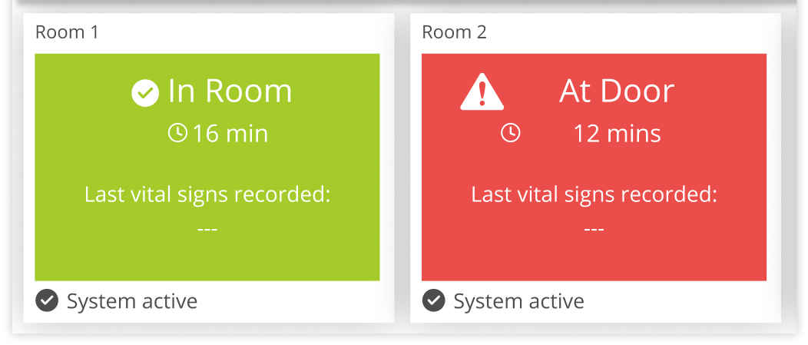
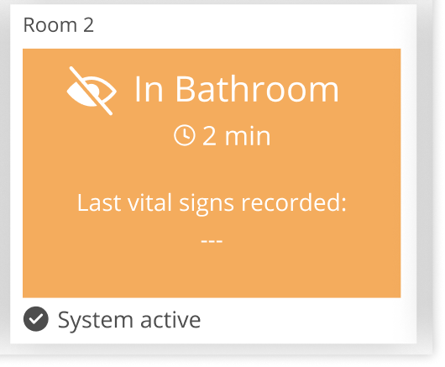
Oxevision: Alerts and Warnings
Oxevision’s algorithms “see” movement in the room
Warnings and alerts are triggered, informing you of activity which may mean a person needs help or assistance:
Warnings are visual only
Alerts are visual AND audible, and must be manually disabled by a member of staff
If you wish to see an anonymised (blurred) 15 second live feed of a room during an alert, select “View”. Otherwise select “Reset”.
Note: Oxevision can take up to 40 seconds to confidently change the state on a room tile. For example, before confirming the room is “Empty” when a patient exits the room. During this time the tile will continue to show ‘In Room’

Slide 11
Reports
Providing additional insights which can help inform care planning
¹ Vital Signs Trends: Registered as a Class IIa medical device in the UK & Europe
² Activity Report: Not a medical device
Reports on risk factors over time^{1, 2}

Slide 12
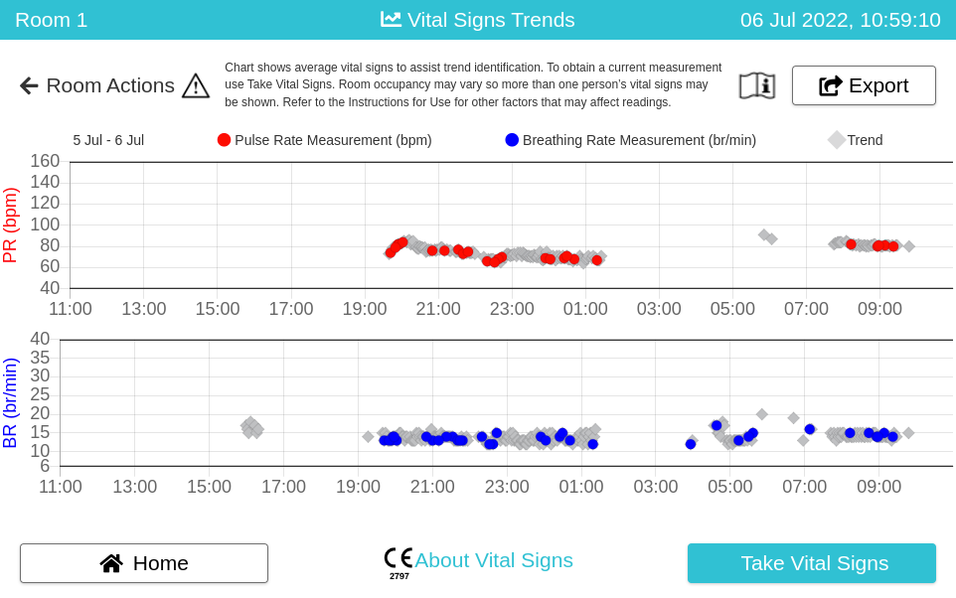
Vital Signs Trends
Vital Signs Trends chart:
Charts a patient’s breathing rate and pulse rate for last 24 hours
Spot-check measurements indicated with red and blue dots
Trends (grey dots) shows a summary of average vital signs to provide additional insight into the patient’s recent state and surface any underlying trends which may be of interest to staff

Slide 13
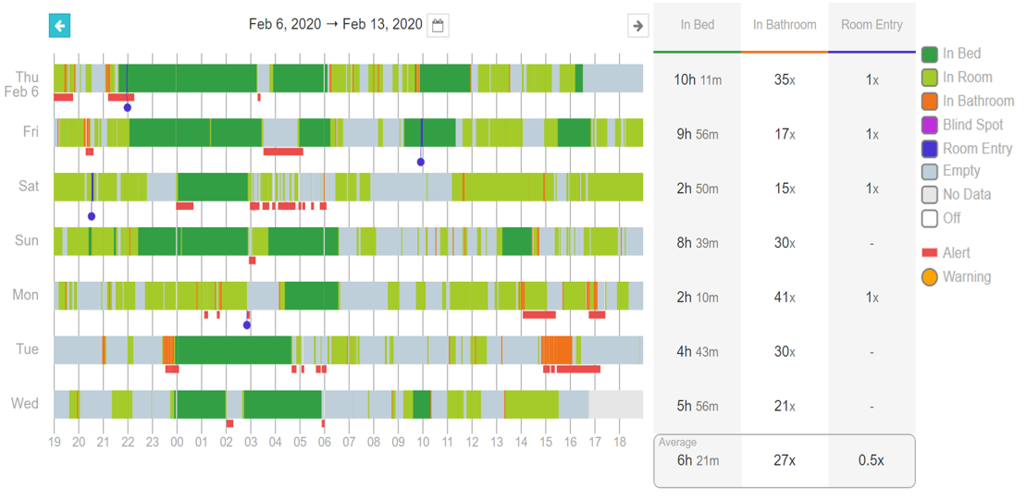
Activity Report
Supporting improved care planning
Insight
Ben’s low mood = long periods in bed
Action
Staff changed care to give more structured routines, different medications, and therapeutic interactions
Result
Mood improved = less time in bed and anxious episodes decreased.
Read Ben’s story

Slide 14
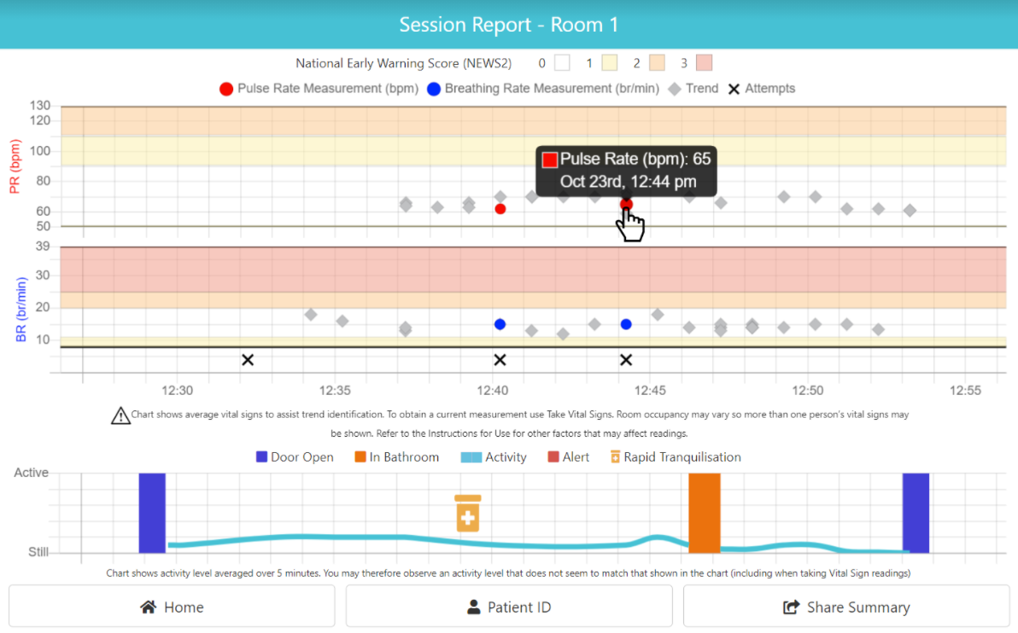
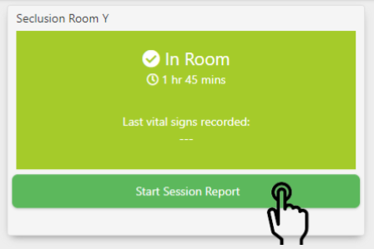
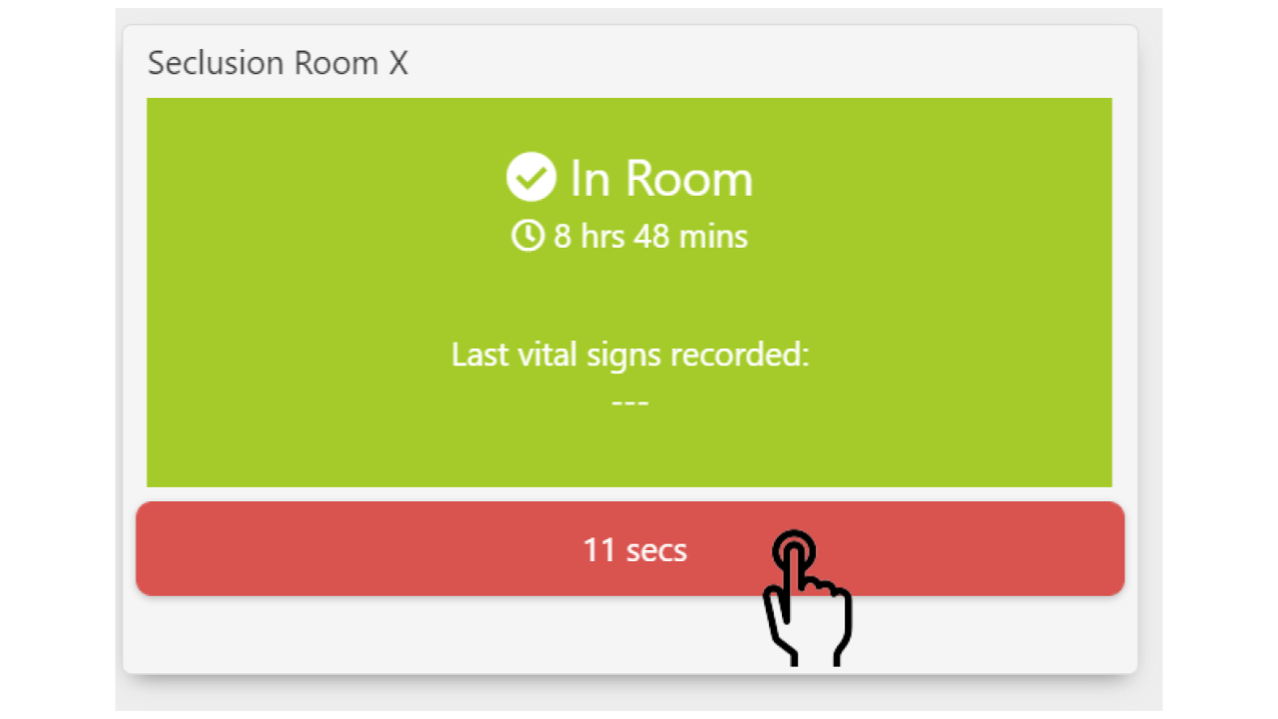
Seclusion Session Report³
Seclusion
Visual overview of a seclusion session, including:
Spot-check measurements and Vital Signs Trends
Activity levels
Rapid tranquilisation (RT) administration (optional).
To start a Seclusion Session Report - select “Start Session Report” button
To end a Seclusion Session Report - select the button again
*Door open in development
The report updates as the session progresses.
3 Seclusion Session/Reports product is an Electronic Patient Record product and is designed to assist reporting activities within a seclusion environment and is not part of any medical device. See Instructions for Use for intended use, contraindications, warnings, cautions, usage directions and maintenance.
Notes:
Please Say: “staff should not to include personally identifiable information when entering patient ID. This

Slide 15
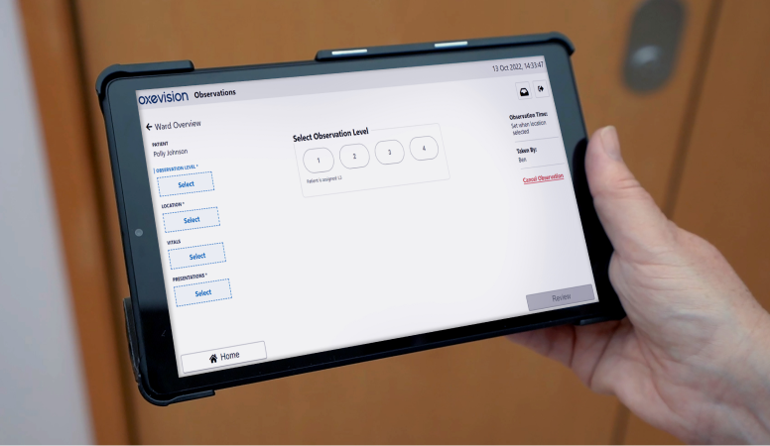


Digital observations designed for mental health

Slide 16

What is Oxevision Observations?
Digital observations designed for mental health
Enabling clinicians to carry out observations that:
Are patient-centred and therapeutically valuable
Increase patient privacy and sleep opportunity
Are accurate, timely, and auditable
Saves 33% of staff time*
*Results across the four wards were normalised to 16 bedrooms so they were comparable. The time savings for the four wards were then averaged to generate results for a single ward that is considered to be representative of all wards in the trust.

Slide 17
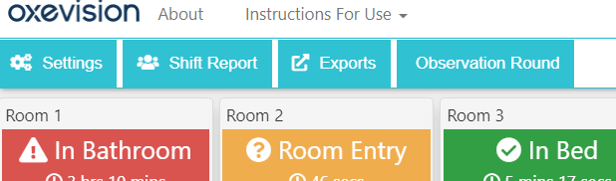
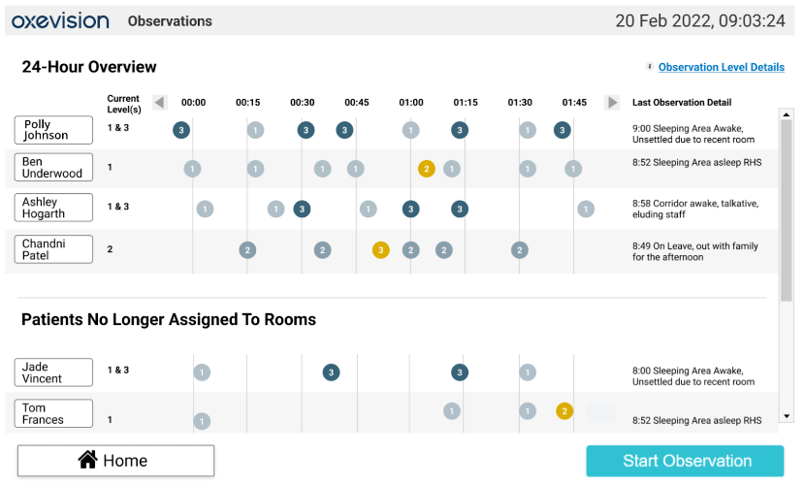
Viewing the 24-Hour Overview
Step 1. Select the “Observation Round” tab.
The 24-Hour Overview displays a summary of all observations taken within the last 24 hours on a ward including:
The patient’s name
The patient’s assigned observations level(s)
The time each observation was taken and the relevant level
A summary of the patient’s last location, presentation(s) and any details and comments recorded during the last observation.
Notes:
On the main overview page, click on “observation round”.
Direct bank and agency staff to the key, the location, and that they can access more background info on their patients by clicking the patient’s name.

Slide 18


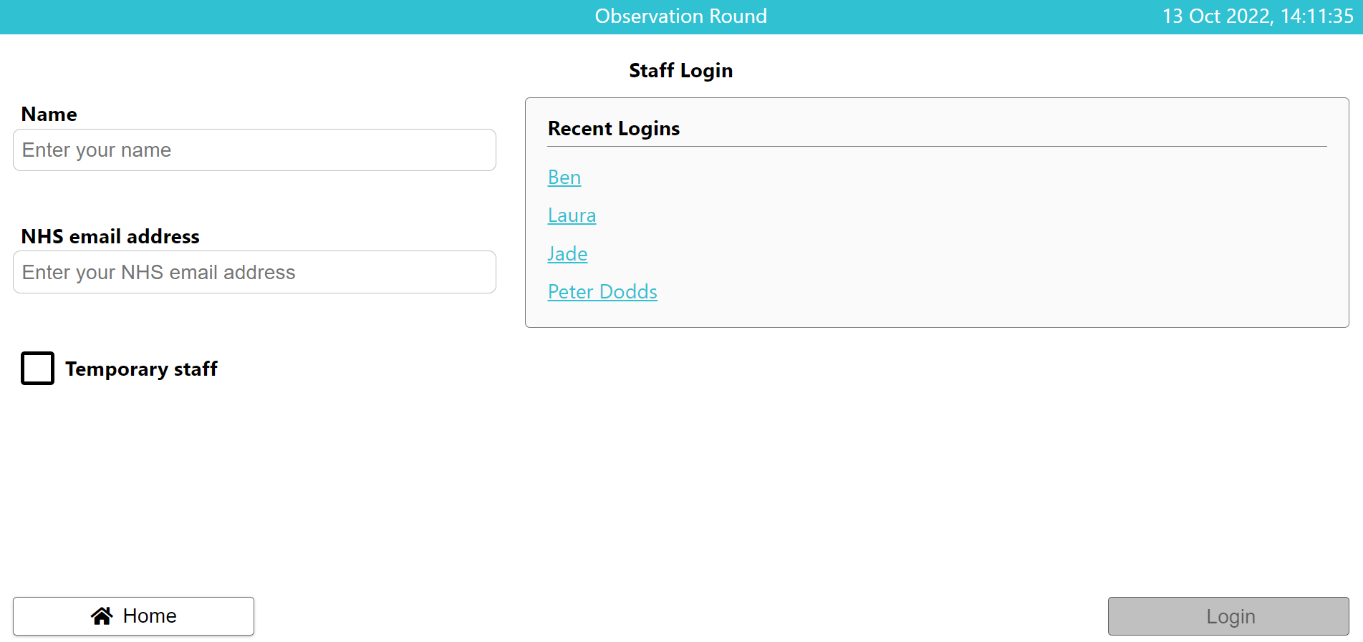

Logging into the Observation Round
Step 1. Select “Start Observation” in the observation overview page.
Step 2. Once you are on the staff login page you must enter your full name and an email address. Note: There is a “Temporary staff” checkbox for bank and agency staff who do not have an NHS email. Once you selected “Login” you will then be taken to the Observation round page.
Notes:
The recent logins will include the last 5 names used and logged in across ALL devices. - speeds up the logging in process
The login button will become available after putting in the login information.

Slide 19
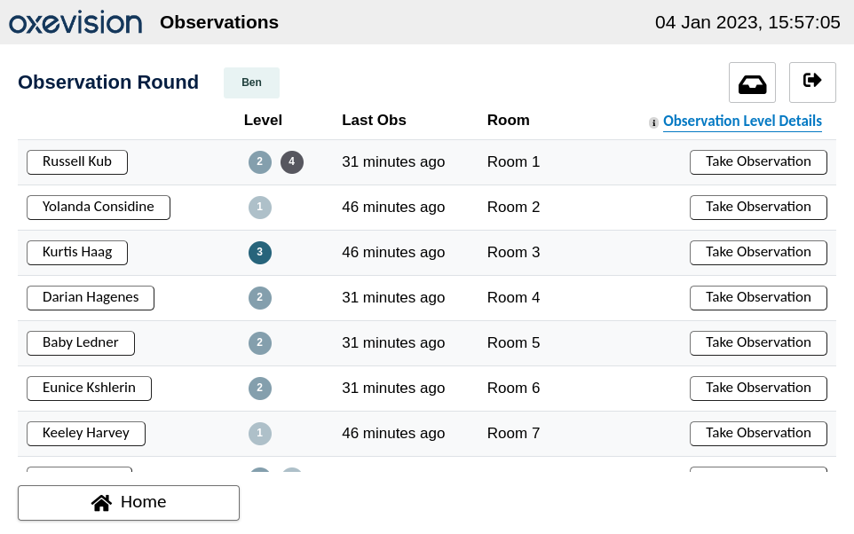
Completing an Observation Round
Step 1: Once you have successfully logged in, you will be taken to the Observation Round page.
Logout button
The Observation Round page shows a list of the current patients on the ward including:
Patient name
Assigned observation level(s)
The time the “Last Obs” was taken
The room in which the patients are currently assigned to.
Selecting “Take Observation” for the individual patient will open the Observation Workflow for the individual patient.
Notes:
Direct them to the new logout button on the top right.

Slide 20
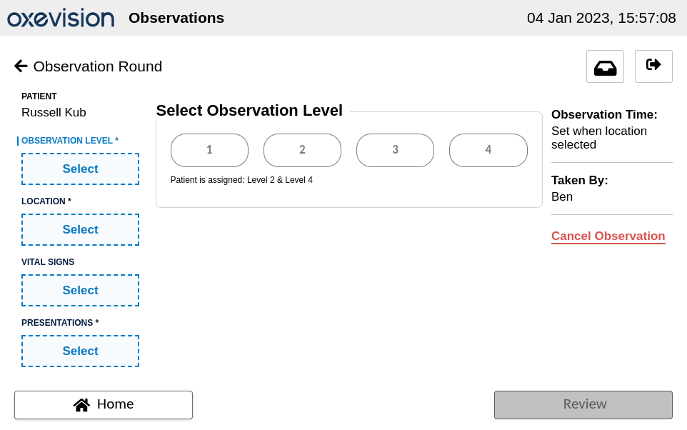
Completing an Observation Round Continued…
Once you have selected “Take Observation” the observation workflow for that patient will appear.
There are four sections within the observation workflow:
Observation level
Location
Vital signs
Presentations and comments
Complete each section by pressing “Select” under the observation field and fill out the relevant information.
Mandatory sections within the observation workflow are indicated by an asterisk.
Notes:
Sections do not need to be completed in order, as long as all mandatory sections are completed, you can move on to the next step.

Slide 21
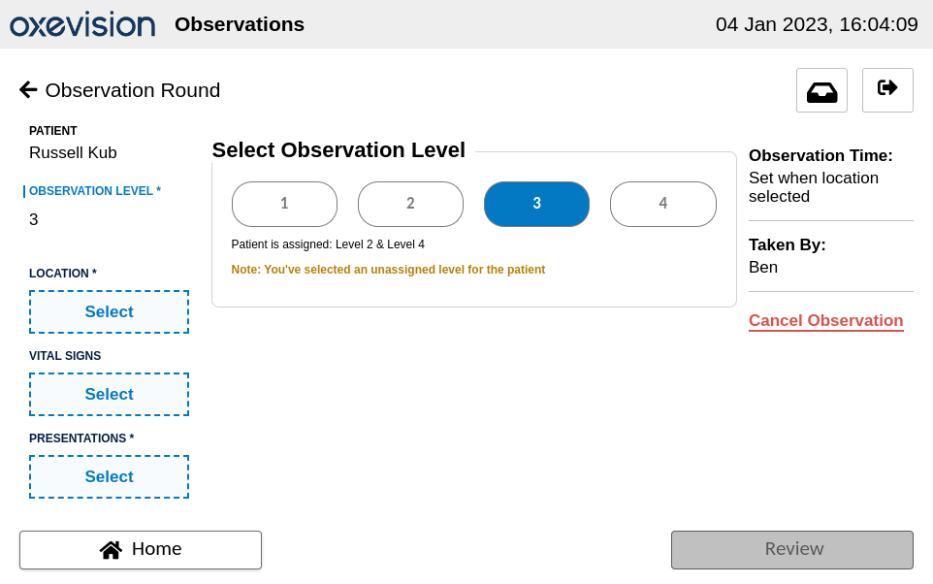
Completing an Observation Round Continued…
Step 2: Select the patient’s Observation Level.
Once a Level is selected it will be highlighted with blue shading and shown in the left-hand summary.
You can either select an assigned or unassigned level for a patient.
The observation level(s) currently assigned to the patient is indicated below the buttons.
If an unassigned level is selected, this will be indicated by yellow text.

Slide 22

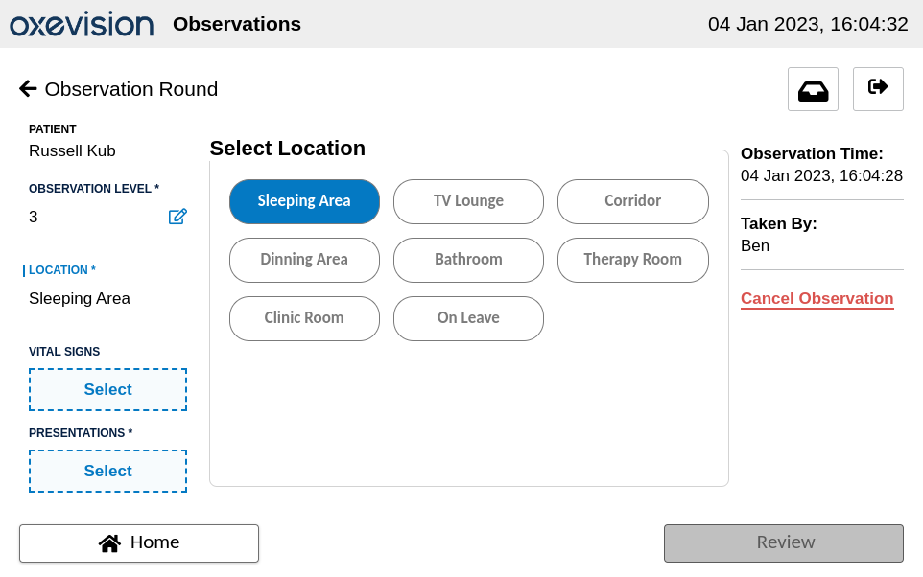
Completing an Observation Round Continued…
Step 3: Select the box on the left under “LOCATION” then select the current location of the patient.
Only one location can be selected and selecting a new location will cause the previous location to be deselected.
A selected location will be highlighted with blue shading and the selected location will be shown in the left-hand summary.
Once you have selected a location the observation time stamp will be updated.

Slide 23

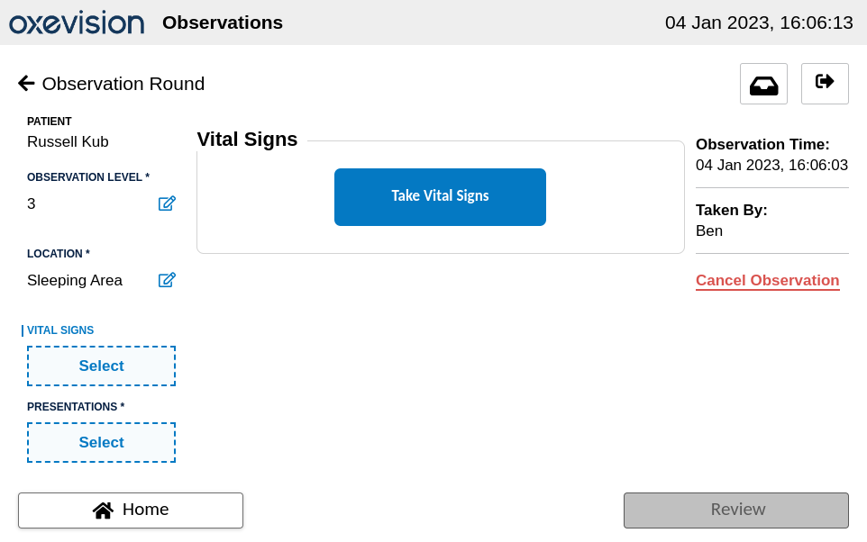
Completing an Observation Round Continued…
Step 4: (optional): If the patient is in their room you can proceed to take their Vital Signs (if the patient is in any other location, you can skip this step). Select the box on the left under “VITALS” and then select “Take Vital Signs”.
Vital signs are an optional field and an observation can be successfully submitted without them.
If vital signs are unsuccessfully taken in the observations workflow, the left hand side summary will remain blank with the ‘select’ option available.

Slide 24

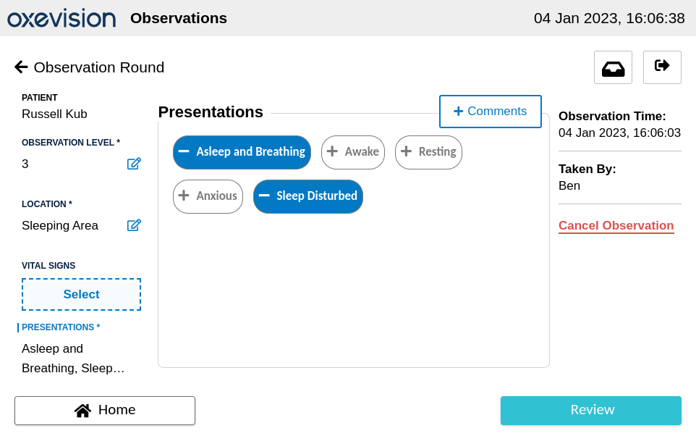
Completing an Observation Round Continued…
Step 5: Select the box on the left under “PRESENTATIONS” and then select any appropriate presentations for the patient.
A selected presentation will be highlighted with blue shading and the selected presentation will be shown in the left-hand summary.
You can also select “+Comments” which allows you to enter any additional information required to support your observation protocols.
Once all the mandatory fields (Obs Level, Location, Presentation/Comment) have been filled in the “Review” button will turn blue.
Notes:
Presentations are configurable. Either presentations and/or comments must be added but including at least one is mandatory. Once all mandatory fields are filled, the review button will become available.

Slide 25
Oxevision at EPUT
Oxevision and Oxevision Observations has been implemented at EPUT
Oxevision is live across 22 wards across EPUT.
Oxevision Observations is being utilised on 7 wards since April 2022, which includes the CAHMS wards.

Slide 26
Thoughts or Questions?

Slide 27
TIME TO CARE
Angela Wade
Director of Nursing, EPUT
Lizzy Wells
Director of Mental Health, EPUT
Hilary Scott Director of
Pharmacy, EPUT
Ian Carr
Director of Specialist Services, EPUT
Mobolaji Lewis
Chief Allied Health Professional (AHP), EPUT
Jenny Matten
Lived Experience Lead, EPUT

Slide 28
CASE FOR CHANGE
The unprecedented challenges of recent years have had an adverse effect on EPUT and our staff’s ability to deliver the safe, therapeutic care we aspire to provide.
High GIRFT data, including high rates of Section 136, ED admission and long waiting lists
Variation across Inpatient and Community resource
Increased demand in areas of deprivation within EPUT’s geography
Increase in demand due to population growth and the socio-economic crisis
Impact of the Covid-19 pandemic
Current Trust scrutiny creating risk adverse practice across the Trust
Significant recruitment and retention challenges
Delays within patient admissions and discharges due to limited availability of wider MDT staff
Capacity challenges and a lack of clear oversight of patient flow
Disjointed and inconsistent therapeutic offer due to resource pressures
Core clinical roles undertaking activities outside of their remit
Lack of clinical leadership across a 24/7 period
STAFF
People miss having a focus and purposeful activity in day to day life on the ward
Some people don’t know about or understand their care plan and the support in place for them
Family and carers are not always informed and are not always effectively taking role in care
Feeling that staff don’t have time or are busy elsewhere
Some people do not feel supported to make the transition to life after ward
Some people feel dehumanised
SYSTEM
PATIENTS
Notes:
Ian – 2 mins

Slide 29
OBJECTIVES AND SCOPE
The overall objective of Time to Care is to release significant & quantifiable time to care on inpatient mental health wards
Staffing Model Redesign
Improving Processes
Improving use of data and technology
Engagement, Inclusivity & Wellbeing
Co-creation and implementation of proposal with staff
Supporting wellbeing and recognition of wellbeing challenges
Notes:
Ian – 2 mins

Slide 30
NEW OPERATING MODEL FOR ALL WARDS
Over the coming months we will develop and implement a new innovative operating model for all wards, which will be integrated with place based community models and the wider system to enable us to provide high quality therapeutic care and holistic support to patients.
PURPOSEFUL ADMISSION
Ensuring that people are only admitted to inpatient care when they require assessments, interventions or treatment that can only be provided in hospital. They are admitted to the most suitable available inpatient provision for their needs and there is a clearly stated purpose for the admission.
THERAPEUTIC INPATIENT CARE
Care is planned and regularly reviewed with the person and their chosen carer(s) so that they receive the therapeutic activities, interventions and treatments they need each day to support their recovery and meet their purpose of admission.
PROACTIVE DISCHARGE PLANNING & SUPPORT
The person's discharge is planned with them and their carer(s) from the start of their inpatient stay, so that they can leave hospital as soon as they no longer require assessments, interventions or treatments that can only be provided in an inpatient setting. Post-discharge support to be provided promptly on leaving hospital.
Notes:
Lizzy – 2 mins

Slide 31



BENEFITS FOR PATIENTS
Example Interventions
Specialist support and interventions to meet individual needs
Psychological therapies
Occupational therapy assessment & discharge planning/outreach
Social support - housing, finances, social inclusion, social network mapping
Peer/lived experience support
Physical health interventions
Regular mental state and medication review
Pharmacy support to facilitate adherence to medicines and prepare for discharge
Relapse prevention
Group work and 1:1 support
Family Group Conferencing
Services for dual diagnosis
Discharge coordination and support with transition to community
VCSE support
Enable independent and safe mobility
Sensory modulation
Life Skills Groups
Communication skills
Nutrition and healthy eating
Developing positive relationships
Education and employment
support
Money management
Sleep hygiene
Stress management techniques
Using digital technology
Practical medicines advice
Life skills group for older adults
Example Activities
Gym programme and other exercise and physical activity
Music and dancing
Complementary therapies
Creative activities, e.g. arts and crafts
Daily community meetings, enabling people to input into the running of the ward
Gardening group and access to the outdoors
Self care/pampering evenings
Religious or spiritual groups, including the celebration of festivals
Contact with pets/animals
Peer Support Groups
Notes:
Lizzy – 1 min

Slide 32









OUR FUTURE STAFFING MODEL
Through extensive stakeholder engagement, analysis of leading practice and what EPUT needs to achieve to deliver its strategic ambitions, we have designed a staffing model that will enable a purposeful, therapeutic, and trauma informed staffing model which releases quantifiable time to care for patients.
Increased provision of registered care professionals to support quality and safety
Release time to care
INITIATIVES
BENEFITS
Support patient safety and quality
New dedicated roles to support patient, family and carer experience; along with quality and safety
Improve patient, family and carer experience
Increased provision of specialist allied health professionals, psychological services and pharmacy
Support career development and retention
Dedicated non clinical and administrative support to give clinical staff time to care
Drive innovation and enhance productivity
Notes:
Lizzy – 2 mins

Slide 33
Allied Health Professions
Maximise skills to enable and support early discharge planning – improving mental and physical health outcomes
More AHP focused activities, with increased ability to cover leave, training and time out
Activity coordinators on wards 7 days a week to engage service users with therapeutic and meaningful activities
Improved access to dietitians in south Essex to reduce variation in managing dietary and nutrition needs
Increase access to SALT across north east Essex – communication issues/swallowing difficulties

Slide 34
Psychological Services
Increase provision by filling current vacancies and retention planning in adult inpatient psychological services
Increase psychological provision on our older adult wards
To continue to ensure all psychological interventions are purposeful, trauma informed and part of the wider therapeutic offer.
Notes:
Sandy – 2 mins

Slide 35
Pharmacy and medicines optimisation
Pharmacy-led medicines reconciliation
Pharmacy input to ward rounds and MDT meetings to optimise outcome from medicines
Support to use medicines effectively including self-administration prior to discharge
Patient education sessions and medication counselling to improve understanding, support shared decision making and medicines concordance
Referral to the Discharge Medicines Service on discharge (where appropriate)
Notes:
Hilary – 2 mins

Slide 36
Professionally Registered ward based care
Enhancing the traditional RMN 24/7 model
Ensuring professionally registered staff provide individualised person centred, purposeful and therapeutic care whilst in the ward environment
Working in teams which confident, competent and skilled
Trans-professional care: learning and improving care together -RMN, AHP, RGN, Social Worker, RNA
Clinical and restorative supervision and leadership
PNE role and career pathways
Notes:
Angela – 2 mins

Slide 37
Our patients
The importance of involving people with lived experience in shaping our plans
How Time to Care will make a difference for our patients and enable us to provide consistently safe, good quality care that puts patients and families at the heart of everything we do
Notes:
Jenny – 2 mins

Slide 38
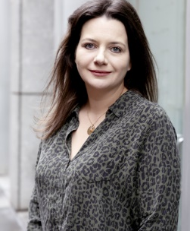






What this means for our patients
These staffing models will enable us to provide consistently safe, good quality care that is person-centred and puts patients and families at the heart of everything we do
KIRA’S STORY
ACUTE ADULT
JOHN’S STORY
MENTAL HEALTH ASSESSMENT UNIT
ADAM’S STORY
FORENSIC
LYDIA’S STORY
CAMHS
SALLY’S STORY
OLDER ADULTS
JACK’S STORY
PSYCHIATRIC INTENSIVE CARE UNIT
DONNA’S STORY
MOTHER AND BABY

Slide 39

Adult acute (overview)
MDT PLANNING
Within 72 hours there is a MDT review. Kira has suffered significant childhood trauma and struggles with an unstable family environment. The Family Carer Ambassador links with Kira’s family on this to get their views.
PSYCHOLOGICAL INPUT
Kira receives regular therapeutic input from OT and Psychological services. They discuss talking therapies and ways of managing intense emotions, helping Kira understand circumstances that may trigger her.
ACTIVITES AND ENGAGEMENT
Kira has a range of activities available to her. The family carer ambassador works with Kira’s family to discuss circumstances preceding admission and identify protective factors, feeding back to social workers that Kira may be better placed in supported living accommodation.
DISCHARGE PLANNING
Kira is ready for discharge. Her case is discussed at a multi-agency complex needs forum meeting and she has an ongoing care plan put in place. The social worker works closely with the discharge coordinator to ensure Kira has appropriate accommodation arrangements.
Kira, 32
ADMISSION
Kira is transferred from
the Assessment Unit after
attempting suicide by a paracetamol overdose.
She had multiple previous admissions and has previously been diagnosed with emotionally unstable personality disorder.
The purpose for admission is identified and clear as ensured by the clinical flow lead.
The 7 day ward administrator ensures documentation from previous admissions is accessible, and pharmacy staff begin medicines reconciliation.
THERAPEUTIC &
TRAUMA INFORMED INTERVENTION WITH
REGULAR MDT REVEWS
PHYSICAL HEALTH
Kira has access to sessions with a technical instructor and benefits from the presence of a RGN to pick up on any additional physical needs.
MEDICINES
Pharmacy staff help Kira learn about the medication she is taking and possible side effects. They also discuss Kira’s history with the MDT and advise the medical team to clarify on the discharge letter that medication should only be prescribed weekly to prevent Kira from taking an overdose.
DISCHARGE
Kira is safely discharged and will be followed up by community mental health services.
Notes:
Presenter: Glenn (5 mins)

Slide 40




The journey to sustainable excellence
We aim to phase in our draft staffing model over around five years. In Year One, we will focus on recruiting high priority roles to enable safe staffing, improving flow and capacity and transitioning from an observation to an engagement model.
YEAR FOUR +
WE ARE HERE
YEAR ONE
YEARS TWO & THREE
PREPARATION
Planning for the implementation of high priority roles through detailed analysis of recruitment needs, job evaluation reviews and change management activities to ensure adequate supporting structures are in place.
SUSTAINABLE AND CONTINUOUSLY IMPROVING WORKFORCE
Continue working towards future target state staffing models, enabling continuous improvement over time and ensuring the workforce is fit for the future.
TRANSFORMING CARE
Moving towards an organisational design that will offer person centred, integrated, accessible and timely care for all, available all day, everyday across the whole care pathway. Enabled through introducing new and innovative roles to meet the needs of patients.
STABILISATON AND RETENTION
Making a step towards a purposeful, therapeutic, and trauma informed service model through enhancing the safe functioning of wards, maximising the skills we have and filling vacant posts through a robust recruitment strategy.
Notes:
Presenter: Angela – we have set a significant and challenging ambition, and we know this will take time to deliver in full. So over the next four years we will move towards a full transformational model, but we also need to see change quickly. To make sure we have the confidence and can gain the confidence of our partners and commissioners, we have broken down the challenge into three phases. In year one we will take a big step forward in terms of delivering a safe environment and moving towards an engagement rather than an observation model - and we will dive deeper into exactly what that looks like shortly. Then in in years 2-4 we will continue the journey towards long term sustainability and continuous improvement, and achieving our vision of being the outstanding provider of MH and Community Services. (2 mins)

Slide 41

THANK YOU

Slide 42
CARRADALE FUTURES
Matt Gee
Co-founder, Carradale Futures
Moriam Adekunle
Director of Safety and Patient Safety Specialist, EPUT

Slide 43
EPUT Safety Conference
Protocolising care to deliver a safer service
Notes:
Kamy

Slide 44
Introducing Carradale Futures
Notes:
Kamy

Slide 45
Carradale Futures is a SaaS healthcare business, supported by an advisory division. We tackle complex problems in healthcare delivery with an underlying focus on unwarranted variation in both administrative and clinical processes.
SOPHIA, our core platform, supports healthcare providers to protocolise care by enabling them to embed within their organisations a library of digitised, optimised SOPs*.
*a written set of instructions that describe, step-by-step, the process that must be taken to properly perform a routine activity
Notes:
Kamy

Slide 46
To date, we have built up one of the largest libraries of healthcare SOPs, covering healthcare settings from primary care, through to hospitals, mental health trusts and community care providers.
Our library grows exponentially as more users interact with the platform – as SOPs are built by users, they become available to everyone in the community to review and interpret for the benefit of their own organisation.
Notes:
Kamy

Slide 47
Our team
Notes:
Kamy

Slide 48


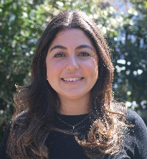


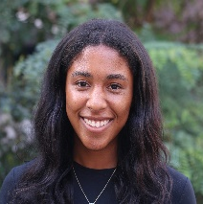
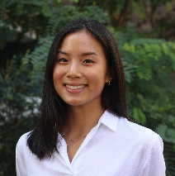
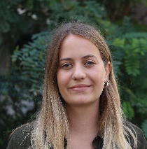
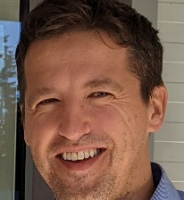
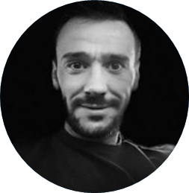
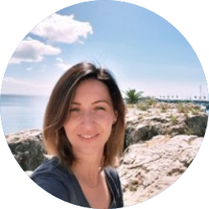

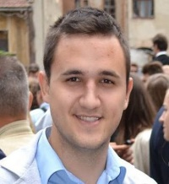
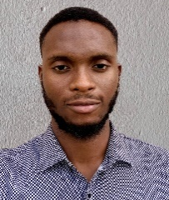
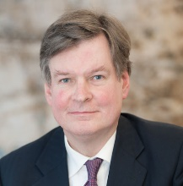
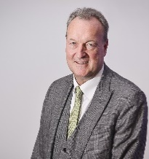
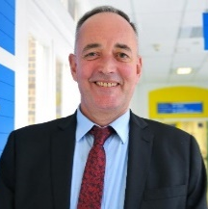

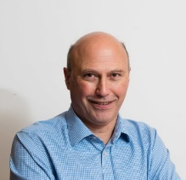
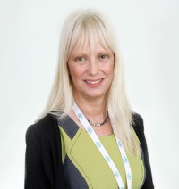
Carradale team
Salamatou Bourdanne
Analyst
Caroline Van de Putte
Associate
Mona El Cheikh
Analyst
Mehri Heybaran
Analyst
Alba Vargas
Associate
Kamy Roberge Carrington
Analyst
Bell Santhudkijkarn
Analyst
Dora Jewell
Principal & Head of Products
Tibor Bruncsak
Senior Developer
Ovidiu Maritan
Delivery Manager
Carmen Biris
Project Manager
Kelechi Odoemena
Power Platform
Szilard Vigh
Lead Developer
Johnpaul Okoji
Power Platform
Stuart Bell, CBE
Acute Care
Mike Farrar
Acute Care
Mike Bell
Acute Care
Sir Mike Richards
Cancer Care
Dr Nick Hicks
Population Health
Ros Alstead OBE
Mental Health
Client support
Platform development support
Market access advisers
Notes:
Kamy

Slide 49
Context for our engagement
Notes:
Matt

Slide 50
Avoidable clinical risk remains at significant levels throughout care systems globally
According to numerous studies, about 50% of adverse events taking place in healthcare systems may be prevented – numerous studies confirm medical errors as a leading cause of death in the U.S.
Where errors are made by people, their behaviours are to a very high degree influenced by the working environment and its processes
Most ‘person centred failures’ can be traced back to system(ic) failures. These systemic failures are often exacerbated by the introduction of new technologies and the unseen impact they have on historical ways of working.
Notes:
Matt

Slide 51
Tackling clinical risk inevitably helps to address avoidable waste
Addressing sources of avoidable clinical risk (e.g. over-use of medicines, inefficient patient transfers, inconsistent discharge processes, inconsistent approaches to outpatient booking) will inevitably help organisations make better use of scarce resources (staff, equipment, facilities)
Waste typically estimated to represent between 20% and 50% of total expenditure in established healthcare markets
Notes:
Matt

Slide 52
Protocolising healthcare delivery
Policies vs SOPs
Notes:
Bell

Slide 53
Protocolisation of healthcare delivery offers one of the simplest routes to tackling unwarranted variation and its downstream impact on clinical safety and waste
Notes:
Bell

Slide 54
Unlike policies which are typically relatively high-level statements of intent, optimised standard operating procedures (“SOPs”) provide a set of clear, step-by-step instructions which promote consistent and uniform delivery of care across an organisation and/or care pathway.
Notes:
Bell

Slide 55
There are a number of consequences to the key differences between Policies and SOPs
Policy
Lengthy, High-level guidelines and principles established by an organisation
Tells reader what to do in theory
Often very long documents which require a significant time commitment to read
Typically, broad and flexible, allowing for multiple interpretations
Can cover many different areas – e.g., a single policy for transfers and discharges
Standard Operating Procedure
Detailed step-by-step instructions for performing specific tasks or processes
Tells reader how to do it on-the-ground – supports independent working
Very concise
Precise and specific, albeit allowing for personal judgement where appropriate
Covers a single process, e.g., separate SOPs for internal transfers, transfers to private hospitals, transfers from OOA, post-discharge follow-up, discharges, etc
Notes:
Bell

Slide 56
SOPs in action
SOPs can be applied to clinical and non-clinical activities, across any care delivery environment
Notes:
Mehri

Slide 57
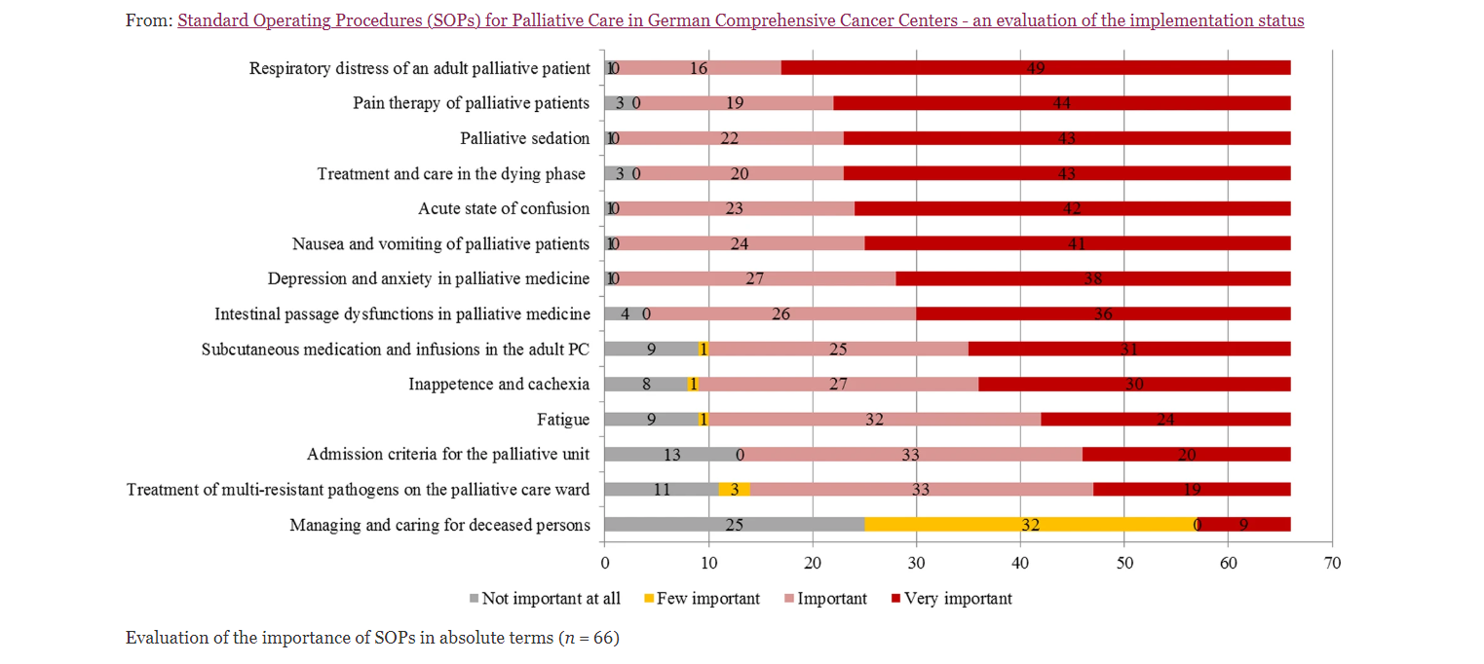
Evaluation of the importance of SOPs in a German comprehensive cancer centre
Source: Standard Operating Procedures (SOPs) for Palliative Care in German Comprehensive Cancer Centers - an evaluation of the implementation status. Sarah Lödel, Christoph Ostgathe, Maria Heckel, Karin Oechsle & Susanne Gahr (2020)
Notes:
Mehri

Slide 58
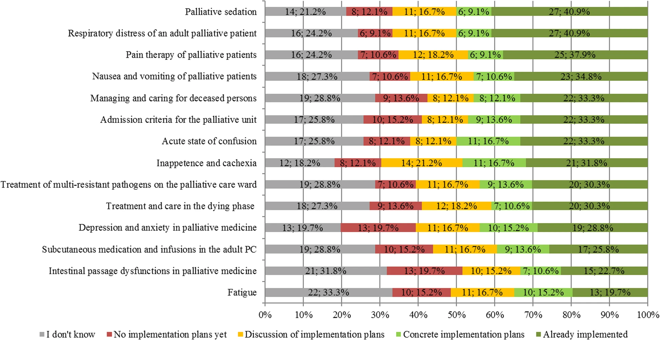
Evaluation of the application of SOPs in a German comprehensive cancer centre
Notes:
Mehri

Slide 59
Our approach/methodology
Notes:
Mehri

Slide 60
Our high level process
Identify SOPs
Co-author SOPs
Digitise access to SOPs
Staff training
Train the trainer for SOP authoring
Identify opportunities for automation utilising RPA
Notes:
Mehri

Slide 61








Our approach in more detail
Creation of process maps
Sign off SOPs
We create flowcharts for each process to provide useful visual aid in addition to the SOP
We review and sign-off SOPs within the Inpatient Safety and Quality Meeting to ensure the SOP will work well on-the-ground
Process improvement
Staff training
We collaboratively define process improvements (such as automating tasks or moving services online)
We train staff so they feel comfortable using all features and functionality
On-site collaboration
SOP implementation
We go into practice and sit with staff while they work to record the SOPs
We upload the SOPs to the digital platform to ensure they are widely and easily-available to all staff
Identify key processes
Ongoing support
We help identify sets of priority processes to be mapped out and optimised
We monitor use and provide ongoing support where needed

Slide 62
Our work at EPUT
Notes:
Kamy

Slide 63
We are proud partners with EPUT in an ambitious multi-year program
Months 18-48
Months 12-36
Months 12-24
Months 1-12
Centre of Excellence
Demonstrating impact
Land and expand
Operational hygiene
Establish EPUT as a thought leader and centre of excellence
Ensure EPUT is able to evidence the tangible benefits of its approach
Broaden use of SOPs to cover far wider spread of processes.
Identify and address key areas of risk and exposure
Notes:
Kamy

Slide 64
We identified 30+ individual SOPs from an initial 10 priority areas identified by EPUT
10 Priority SOP ‘Areas’
30 Individual SOPs
Local induction of staff
Transfer of Patient
Clinical Risk Assessment
Admissions
Post-Discharge Follow-Up
Record Keeping
Disengagement
Identification and Management of Deterioration
Management of Falls
RAG Rating for Care Coordinators
Processes from priority list contained multiple SOPs
‘Admissions’ contains 10 SOPs;
5 pre-admission pathways
2 admission checklists
3 under-18 transition pathways
Notes:
Bell

Slide 65


Working closely with on-the-ground staff has been
invaluable in the development of optimised SOPs
How we have worked with EPUT
Benefits of working closely with staff
A
We gain a clearer undertanding of the current process and shortcomings
B
We build trust with staff so they are open and comfortable discussing their painpoints and issues in the process
On-site visits
Remote sessions
C
Gathered data and feedback from circa 124 staff members
Gone on-site over 35 times
Visited circa 4 community teams and 23 wards providing a myriad of services
Led workshops to discuss potential solutions to common challenges
Held regular remote meetings with an ‘SOP lead’ and team to finetune the details and review the SOP before final sign-off
Staff are able to identify additional processes that need improvement – circa 10 staff-initiated SOPs to date
D
We ensure all opinions, especially clinical input, from staff on all levels are included to create SOPs that work well on-the ground and according to best practice
E
We are able to closely monitor and support with any further changes post-implementation
Notes:
Mehri

Slide 66




On-the-ground staff are now proactively driving the project forwards by initiating their own SOPs
Under-18 Transition SOPs
Starting Clozapine Treatment in the Community
Medical Device Procurement & Decommissioning
Other staff-initiated SOPs that have been proposed
Alongside the admissions SOPs, staff requested to add 3 under-18 transition SOPs to capture a young patient moving to adult services
In conjunction with efforts to develop virtual wards at EPUT, this SOP was requested to bring services together and ensure patients could safely start Clozapine treatment in the community
After several conversations with the deterioration and falls SOPs leads, there was a clear need for medical devices to be monitored and handled efficiently
Transfers from OOA
Medical Device Use
Discharges
Disengagement from PH services as a result of MH
Notes:
Caroline

Slide 67
Measuring impact
Notes:
Caroline

Slide 68
Measures of success that we aim to track over time are many and varied
Time to onboard new staff
Time released for patient facing care
Improved data quality
Improved auditability
Staff satisfaction
Patient satisfaction
Notes:
Caroline

Slide 69

We’ve interviewed circa 125 staff members to gain a better understanding of the processes
Generic questions, relevant to all SOPs
  Personal experience with the process
  What is working particularly well and main painpoints
  When/how to escalate in process if needed
  Rating process on a scale of 1-5 based on 5 key metrics;
    Safety
    Efficiency
    Handovers & communication
    Systems
    Training and Guidance
Time taken to complete process
Changes staff would make to improve process
Notes:
Caroline

Slide 70
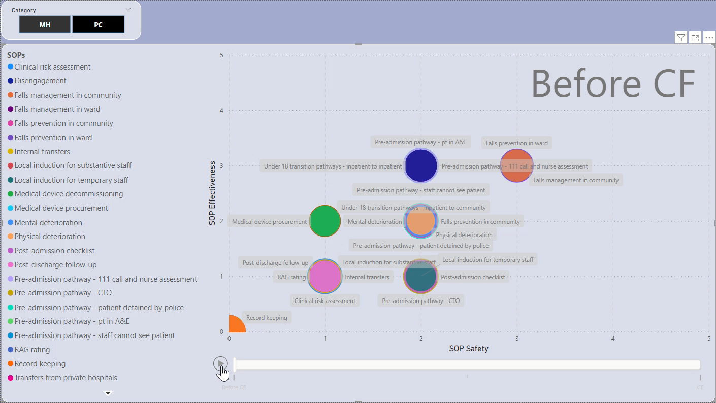
We are anticipating improvements across both safety and effectiveness
We measure the Effectiveness and Safety of each SOP before and after the optimisation process (approximately 3 months per SOP)
Each SOP is rated on a scale of 0-5 for both variables in terms of quality
Each SOP is also rated regarding Priority – a larger bubble indicates a higher priority
Takes into regard Lean Six Sigma methodology, SOP expertise and previous experience, data and feedback from staff

Slide 71
Thank you
Notes:
Caroline

Slide 72
BREAK
Join us again at 3pm

Slide 73
ASSERTIVE COMMUNICATION, CULTURE, & PATIENT SAFETY
Dr Roslyn Mattukoyya
ARU

Slide 74
SAFETY PANEL: Q&A SESSION
Mark Dale
EPUT Patient Safety Partner, Governor - Panel Facilitator
Angela Wade
Director of Nursing, EPUT
Moriam Adekunle
Director of Safety and Patient Safety Specialist, EPUT
Lizzy Wells
Director of Mental Health, EPUT
Ian Carr
Director of Specialist Services, EPUT
Hilary Scott Director of Pharmacy, EPUT
Mobolaji Lewis Chief Allied Health Professional (AHP), EPUT
Janet Wood
Non-Executive Director, EPUT
Manny Lewis, Non-Executive
Director, EPUT
Dr Mateen Jiwani
Non-Executive Director, EPUT

Slide 75
CLOSE
Alex Green
Executive Chief Operating Officer, EPUT

Slide 76
EPUT SAFETY CONFERENCE

